Slide 1
Design For SideScroller

Slide 2
The General Splitting
Since this is going to be a complex game, in order for maximum efficiency, we will need to split it up the different aspects of it.
Characters Classes
Items Classes
Setting Class
Many different Checkpoint classes called Checkpoint1.java, Checkpoint2.java, etc
All the checkpoints will be listed in Application constructor

Slide 3
Character Classes
Main Character Class
Image Icon
Ability to float/fly
Ability to go through things
Ability to go in and out of human beings (Exorcism kind of)
Ability to pick up various clues
Has an energy/health bar
Townspeople Class
Should have various Weapons
Has to know where Witch is, and must always try to attack her with Weapons

Slide 4
Character Classes (cont.)
Witch Class
Needs to be able to jump, move left and right
Needs to be able to perform various attacks
Needs to have a counter move
Ability to pick up various clues and weapons
Has a health bar

Slide 5
Items Classes
Contains 2 subclasses
Weapons
Clues
Weapons Class
Contains many subclasses for every type of weapon that needs to be created
Clues Class
Contains many subclasses for every type of clue that needs to be created

Slide 6
Settings Class
Contains several classes depending on what type of setting character is in
INSIDE THE TOWN
Inside a House setting
ArrayList of all of these ImageIcons
Main road setting
Arraylist of all of these ImageIcons
Side road settings
ArrayList of all of these ImageIcons
OUTSIDE THE TOWN
Area right outside town
ArrayList of all of these ImageIcons

Slide 7
Checkpoint classes
This is where the game logic takes place
Many different Checkpoint classes, all of which are called in chronological order in a huge Game class
Game class is called in Constructor

Slide 8
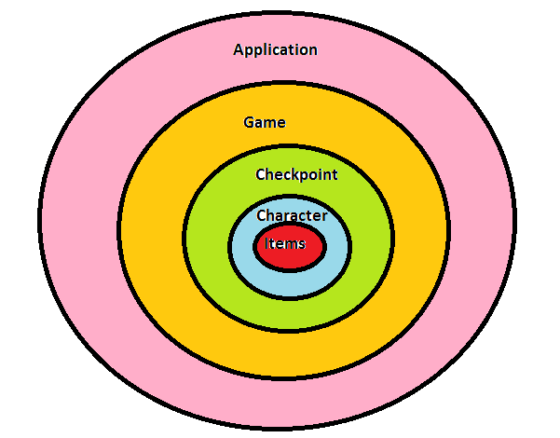
Basic Image of Envisioned Design

